Slide 1
Attack Surface Analysis Model Analysis
AVCDL-Design-3.1.2
Charles Wilson
Staff Product Cybersecurity Architect
version 4
2026-07-02
Notes:
Script:
I'm Charles Wilson, Staff Product Cybersecurity Architect at Torc Robotics.
This presentation will cover Attack Surface Analysis - Model Analysis.

Slide 2
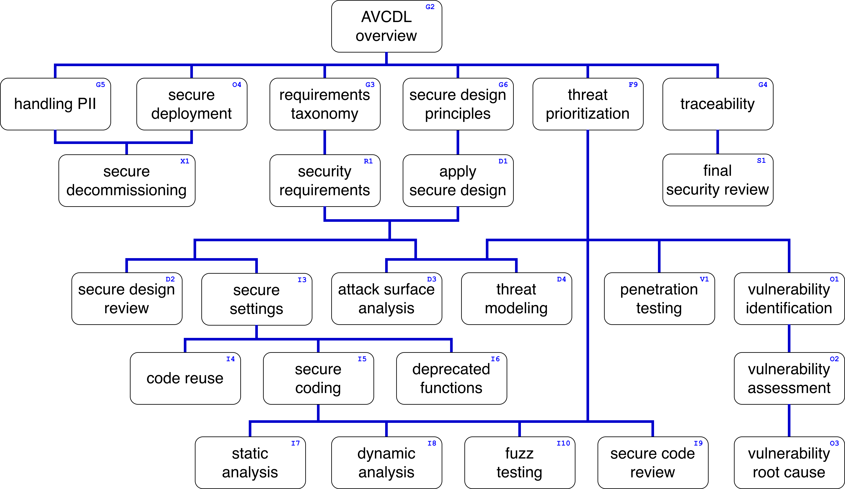
Training Path
Notes:
Script:
This diagram shows the overall AVCDL training path.
If you're taking this training, it's assumed that you've already completed the AVCDL overview training,
and additionally, that you've completed the
requirements taxonomy
security requirements
secure design principles
apply secure design
and
threat prioritization trainings
Additionally, you should have completed the attack surface analysis overview and model creation trainings.
This training will cover attack surface analysis model analysis.

Slide 3
Introduction
Notes:
Script:
Before getting into attack surface analysis model analysis, let's briefly review where it fits in the overall attack surface analysis process.

Slide 4
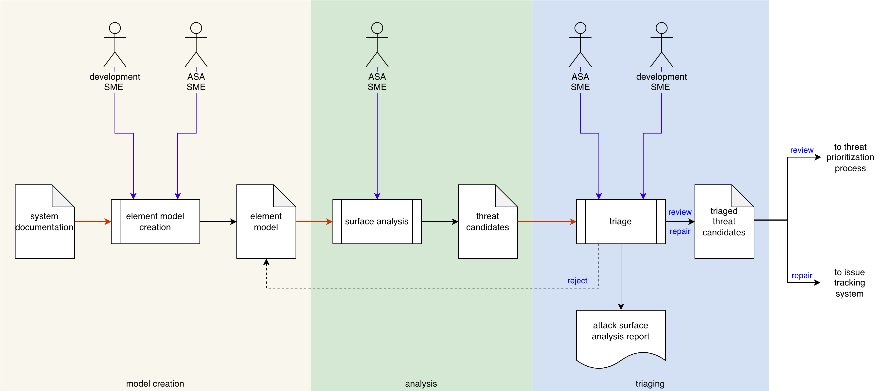
Attack Surface Analysis Process
Notes:
Script:
Here's the attack surface analysis process which we previously covered in the Attack Surface Analysis Overview training.
[break]
Our focus for this training is going to be on the second activity, that of performing the analysis.

Slide 5
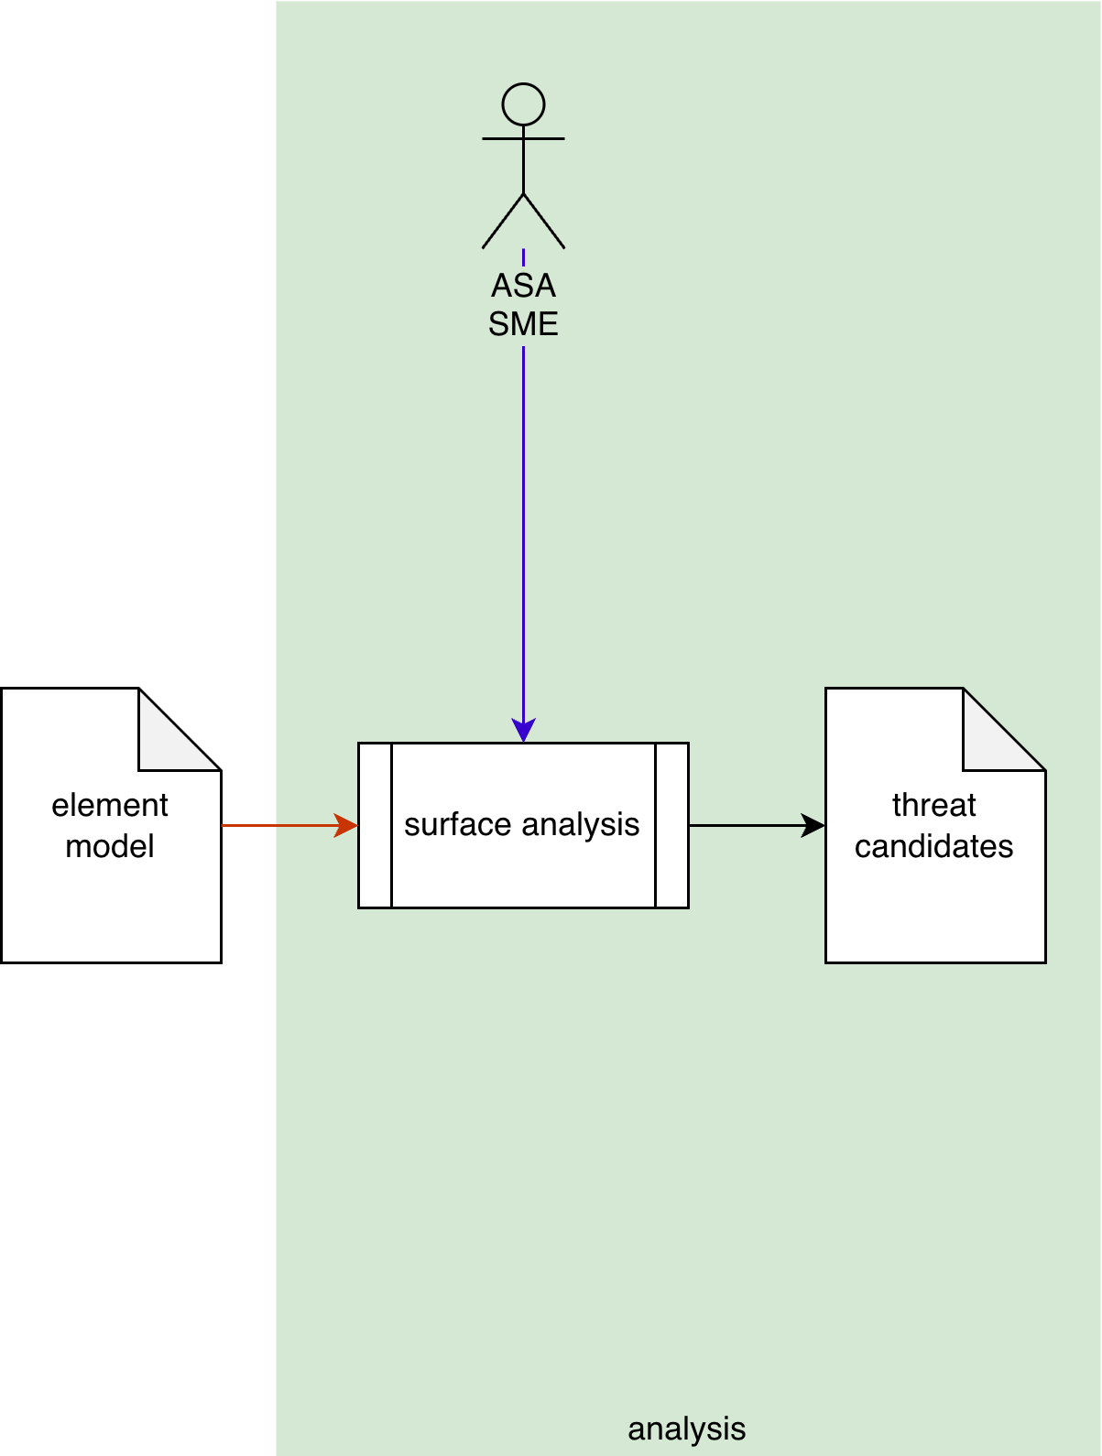
Attack Surface Analysis Process
Notes:
Script:
Here's the attack surface analysis process which we previously covered in the Attack Surface Analysis Overview training.
[break]
Our focus for this training is going to be on the second activity, that of performing the analysis.

Slide 6
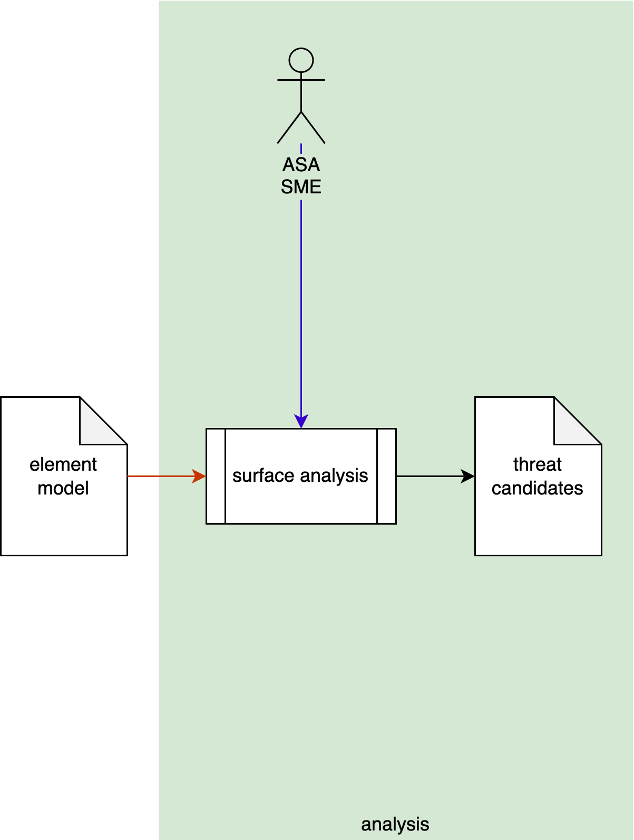
Analysis Activity
Notes:
Script:
Within the analysis activity,
[pause]
The ASA SME takes
[pause]
the instrumented element model
[pause]
and performs an attack surface analysis,
[pause]
generating a list of threat candidates.

Slide 7
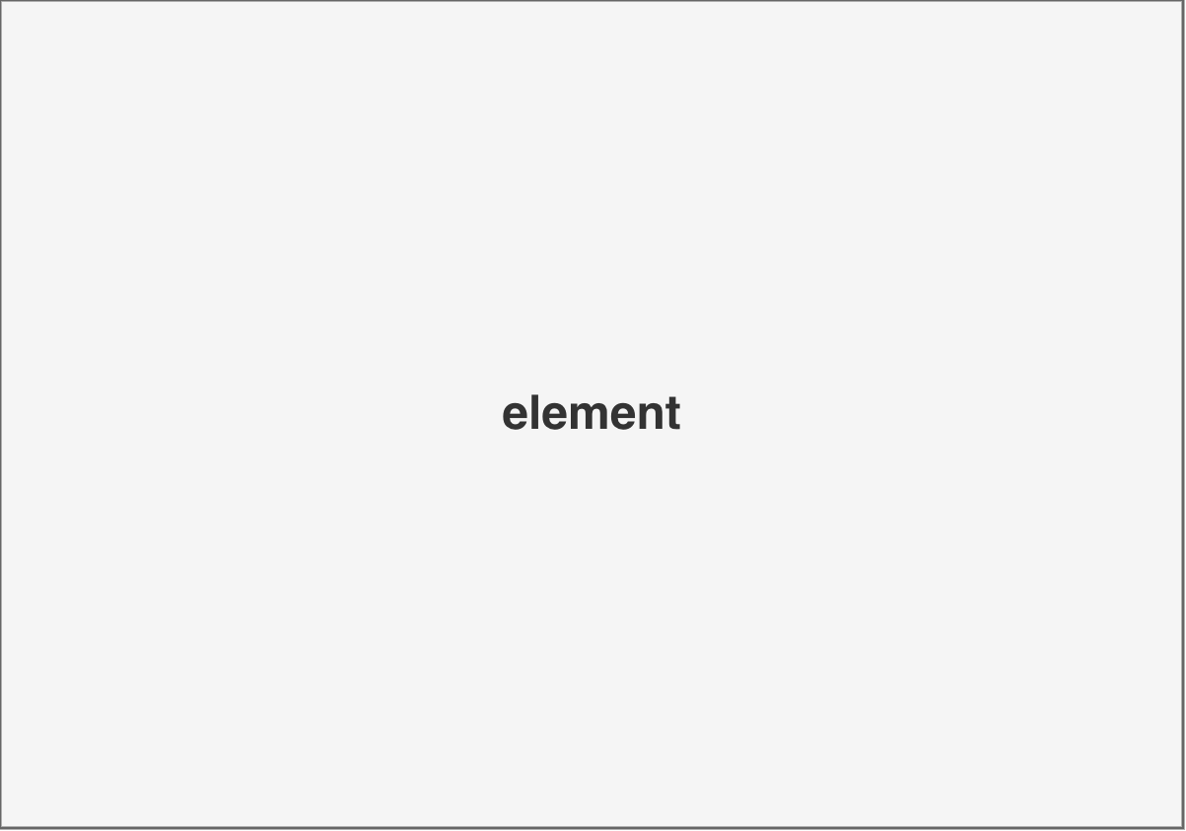
Entities of Interest
Ports
Protocols
Processes
Notes:
Script:
To review, when we're performing an attack surface analysis, we are constraining ourselves to a particular element.
Which is an arbitrary subdivision of the system.
Now, within that context, we're thinking about three distinct types of entities, and these are:
• Ports
• Protocols
and
• Processes
And that's it.
That’s all we need when we're dealing with attack surface analysis.
Now, let's look at the example system and see how it decomposes.

Slide 8
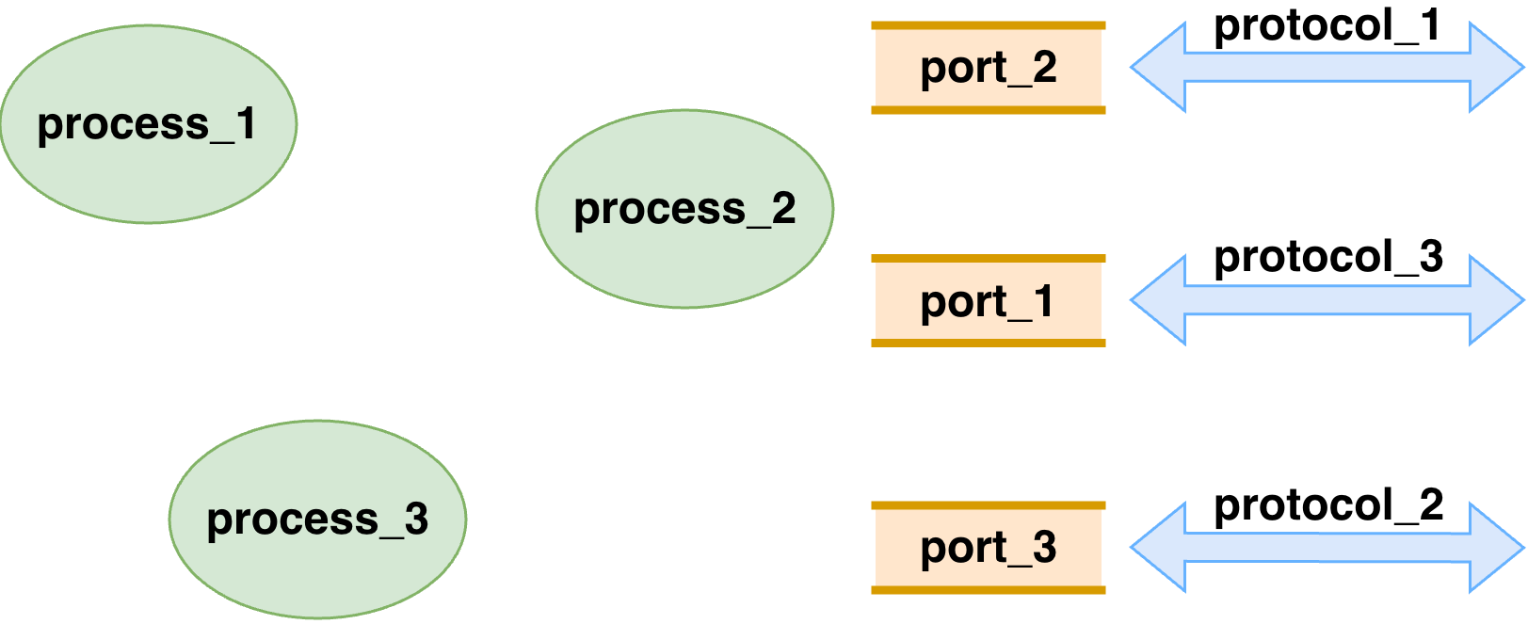
Notes:
Script:
Overlay slide

Slide 9
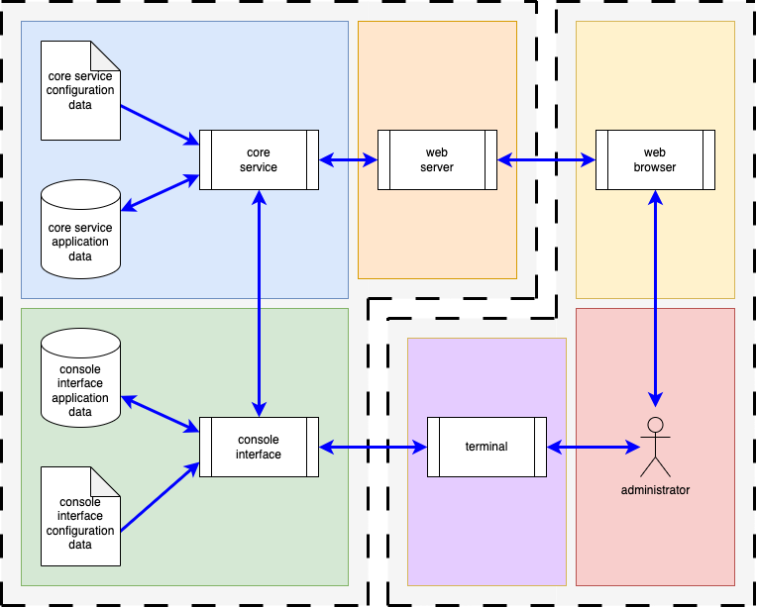
Block View
Notes:
Script:
Once again, here's the block view of our example system.
We have the system and the entity that’s interacting with it.
We've got the processes, interactors, data being used, and data flows going between the various entities.
With the attack surface analysis, as mentioned, we only care about the three entity types that we've just discussed.
Let's consider how that reduction occurs.

Slide 10
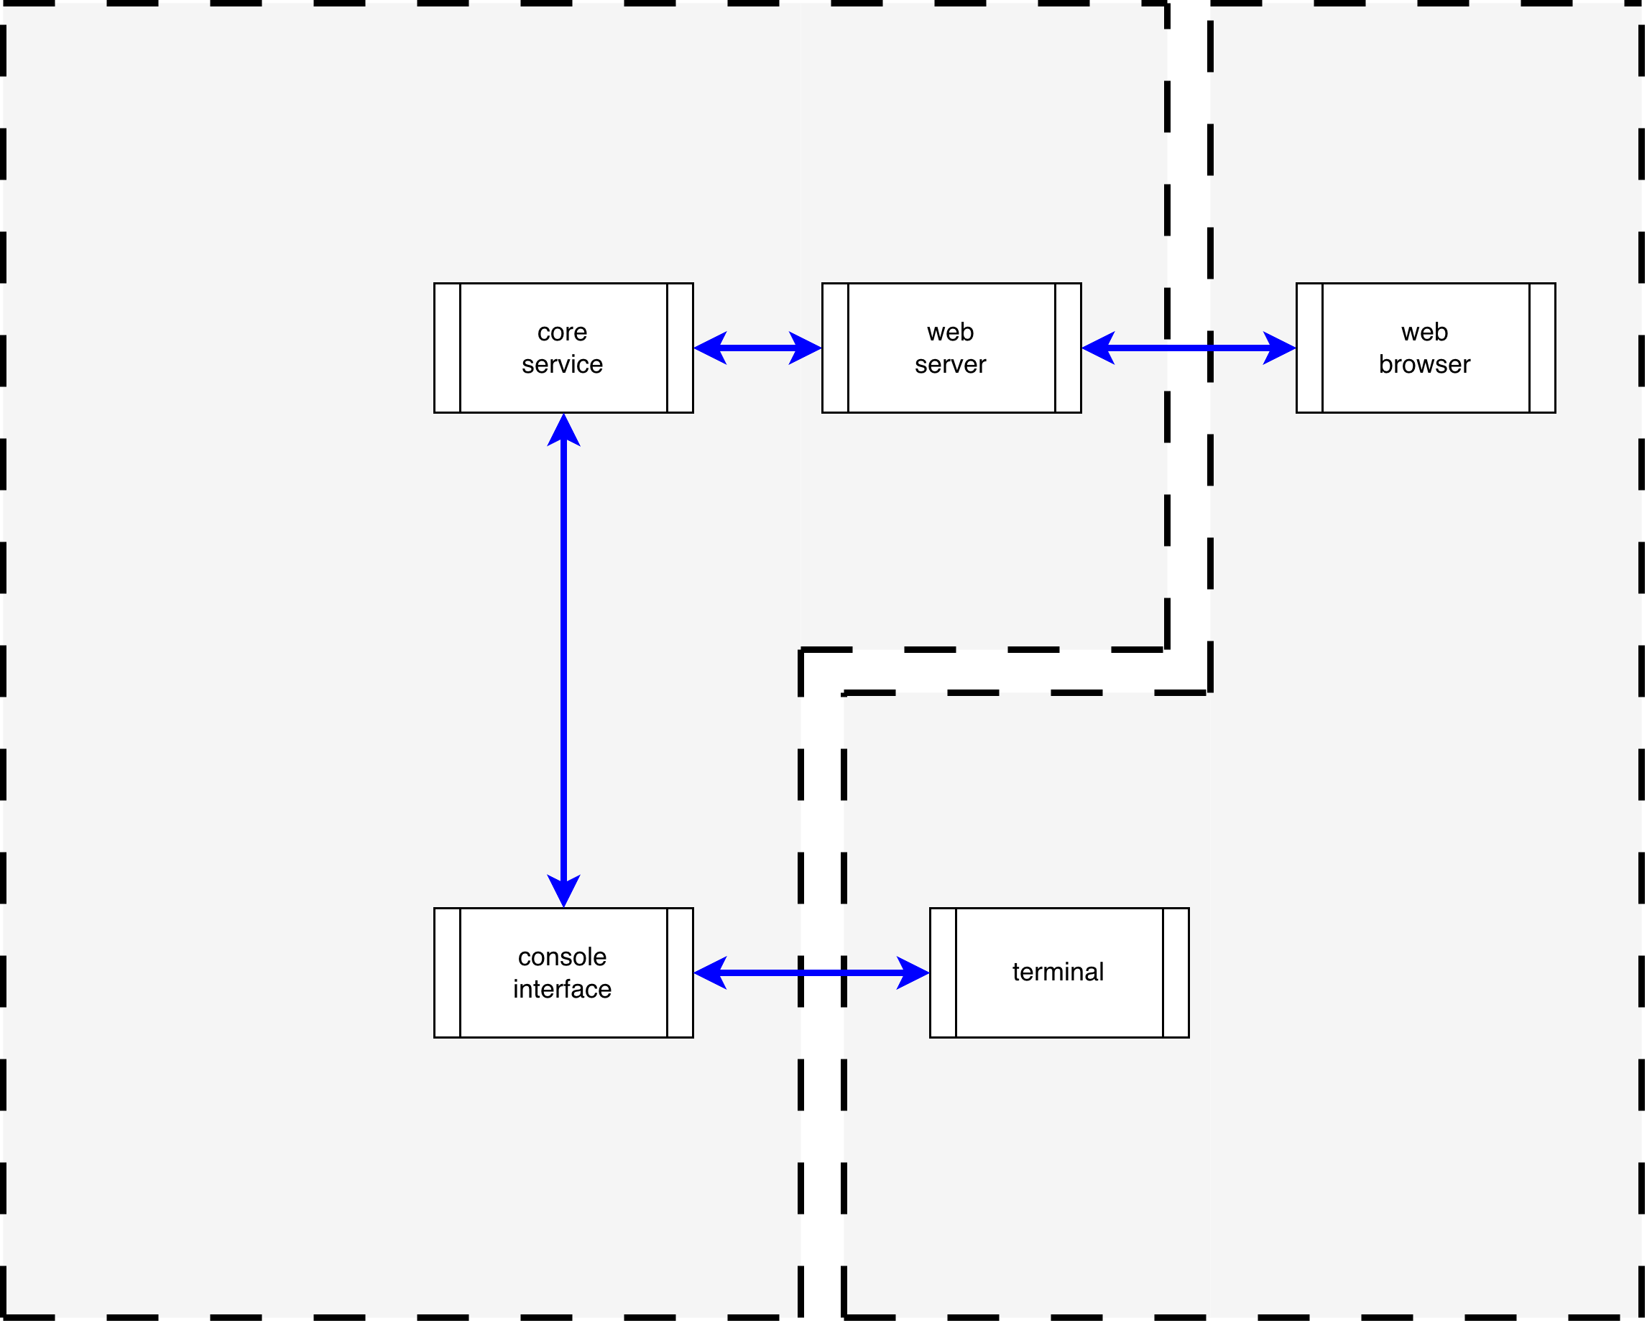
Entities
Notes:
Script:
Here’s the block view reduce to only the entities of interest, those being the ports, protocols and processes.
There are only a few things we need to consider, and this is good because it makes our analysis that much easier.
As we can see here, we have the web server, core service, and console interface as the processes we care about.
We have the interactions that are going on between them.
We have, diagrammatically at least, indications of what the ports that we care about are.
From here we can extract the information that we need.
Now let's look at our analysis process.

Slide 11
Analysis
Notes:
Script:
The analysis that we perform will be based on taking the entities and subjecting them to a series of questions, which will determine whether or not the entity is properly constrained.
The questions that we cover will make the term “properly constrained” fairly obvious.
Let's look at each of the entity types and corresponding questions we're going to pose for each of them.

Slide 12
Physical Port Questions
Is the port used?
Is the port required for the core functionality of the element?
Is the port only required during development?
Is the port only required for diagnostics?
Is the port only required for deployment?
Is the port removable?
Notes:
Script:
When considering physical ports, we start with what is probably the most obvious question, is the port used?
This is the easiest question to be able to answer, and you should have the information that you need here in the model that's been created.
Either this particular hole in the box serves a purpose toward the functional requirements or it doesn't.
[pause]
Our next question is whether the port is required for the core functionality of the element.
Now, this question is one which is useful in a safety-critical system because it informs whether or not the port is going to be impacted if there is a need to degrade the operation of the system.
If something is not necessary for the core functionality, then it can be disabled.
This is, strictly speaking, not a necessary question in order to constrain a particular port, but it does inform other aspects of cybersecurity.
[pause]
Our next question is whether the port is only required during development.
This is an important question because during development, there are going to be needs that the development team has with respect to an element or the system in general, allowing it to be able to peer into the box.
And so, there will, in all likelihood, be extraneous ports that are used for this purpose.
In production, these ports should not be there because development has ceased and production equipment is minimized to what is necessary.
[pause]
Similarly, we can ask whether the port is required for diagnostics.
Now, there's a fine line between the needs of development and those of diagnostics post-development.
Generally speaking, from a cybersecurity perspective, we wish to make it impossible for entities other than those authorized to access this type of data.
And so, we want to make sure that if you need to do diagnostics, there are controls in place that don't provide access to those who should not have it.
[pause]
Next is the question of whether the port is only required for deployment, and by this we include provisioning, update, and decommissioning.
This is important because there are some systems where provisioning and update are done in a highly-controlled environment, and others where they will be done remotely.
As with diagnostics, it’s desirable to not have things exposed that don't need to be exposed.
[pause]
Which leads us to the next question, is the port removable?
Is there the capability of having a port that can be removed, and when necessary attached.
If you have an unnecessary port, is it possible to remove the physical interface connector from the system or simply not populate it.
Should it be necessary for diagnostics or deployment at a later date it can be added at that time.
When it's not there, a physical barrier should be installed over the hole in the enclosure.
[pause]
And that takes care of our physical port questions.
As a side note, it's important to keep in mind that there is a distinction between product cybersecurity and physical security.
With physical security, we're talking about things like locks, covers, and tamper evidence seals.
These are outside of the scope of the product cybersecurity attack surface analysis, and therefore, outside of our consideration here.
If any of these concerns intersect with this analysis, they should be recorded in the appropriate risk register and communicated to those responsible for such issues.

Slide 13
Logical Port / Protocol Questions
Is the port used?
Is the port number appropriate?
Is the port required for the core functionality of the element?
Is the port only required during development?
Is the port only required for diagnostics?
Is the port only required for deployment?
Is the port owned by a single process?
Is the port only open for the duration required by the operation?
Does the port’s protocol require non-trivial authentication?
Notes:
Script:
We consider the logical ports and protocols collectively.
We're going to start with the same question we ask regarding physical ports.
Is the port used?
Unlike physical ports where you can just take a picture of the element and see that a hole exists in its enclosure, when it comes to logical ports, you have to be told that a logical port is being used.
You can’t simply scan the system to see if a port exists because a port is a construct, and it can be spun up and torn down the same way that you would a file channel.
Additionally, since the attack surface analysis is a design activity, there’s no software to scan.
[pause]
The next question that we have is, is the port number appropriate?
This can be a difficult area to communicate since logical ports are just constructs, and they can be assigned any value programmatically.
Many developers simply pick a number that’s convenient for them.
However, the use and assignment of logical port numbers is governed by the IANA.
[pause]
It's important that we not use a port which is registered for another purpose, because firewall port and protocol checkers are going to flag these as invalid communication.
Additionally, the IANA only allocates one port to an organization and expects that port multiplexing will be used when multiple protocols are employed.
[pause]
Our next question is similar to our first set, is this port required for the core functionality of the element.
This becomes important again in a degraded system when we have contention over the media that the communications is taking place.
If you have a situation where you have contention, the highest priority traffic needs to go through, and you need to shed any other functionality (at least temporarily).
[pause]
Our next question, is this port only required for development?
Consider the example where you have a sensor that has a web server on it because that was the easiest way to move data around and examine things.
In production, you shouldn't need that port.
[pause]
Next, is it being used for diagnostics?
If it is then that means that when you are dealing with diagnostics, there are additional checks that you should be making.
[pause]
Similarly, is the port only required for deployment?
There's no point in having a port listener running if you don't have active provisioning or update in progress.
[pause]
Next, is the port owned by a single process?
This is one of those issues of a resource should only be managed by a single process, so that we don't have issues of contention that come up.
Additionally, if you know that the port is only managed by a single process, then you can limit the chance that a rogue process will open that particular port.
[pause]
Next, is the port only open for the duration of the required operation?
This is one of those issues of pressure on the system and attack opportunity.
If you don’t need a port open, don't leave the port open.
This would be akin to having a global variable that happens to have a password in it because it’s easier than fetching it from a password manager when you actually need it.
Keep in mind that a port listener takes up CPU cycles and responds to queries.
There's a whole host of things that can go wrong with this.
[pause]
Finally, does the protocol require non-trivial authentication?
This is especially important when we're talking about things like diagnostics and deployment.
Having a port listener sitting there waiting for a command it will simply execute it is not the way to have a secure system.
For information about what’s meant by non-trivial authentication, the best place to look is going to be in the NIST SP 800-63: Digital Identity Guidelines document collection.
[pause]
As a reminder, references with links are provided at the end of the presentation and in the video description.

Slide 14
Process Questions
Is the process used?
Is the process required for the core operation of the element?
Is the process only required during development?
Is the process only required for diagnostics?
Is the process only required for deployment?
Does the process have a unique owner?
Is the process required to be privileged?
Is the process the manager of a system-critical resource?
Notes:
Script:
This brings us to our third group of entities, that being the processes.
[pause]
Unsurprisingly, we're going to start out with the question, is the process used?
If it's not used then it shouldn't be there.
[pause]
Our next question, is the process required for the core operation of the element?
We've discussed the concept of degraded operation and so I won't belabor that.
[pause]
Is the process required during development?
[pause]
Is the process only for diagnostics?
[pause]
Is it only for provisioning?
[pause]
Now we have a new question, does the process have a unique owner?
This is where we again talk about a resource being managed by a single owner.
Why?
Because one of the controls that we can use to ensure cybersecurity is the access control mechanism provided by the operating environment.
If a process has a particular owner and only they can start the process, then you don't have to worry about the process being co-opted by a different user or entity.
[pause]
A similar question is whether the process is required to be privileged.
This is a matter of least privilege.
[pause]
Finally, is the process the manager of a system critical resource?
This is one of those questions which will guide us to knowing how strictly we need to apply the security controls at our disposal.

Slide 15
Example
Notes:
Script:
With all of these questions in mind, let's turn our attention to the example we've been using and see what we can come up with.

Slide 16
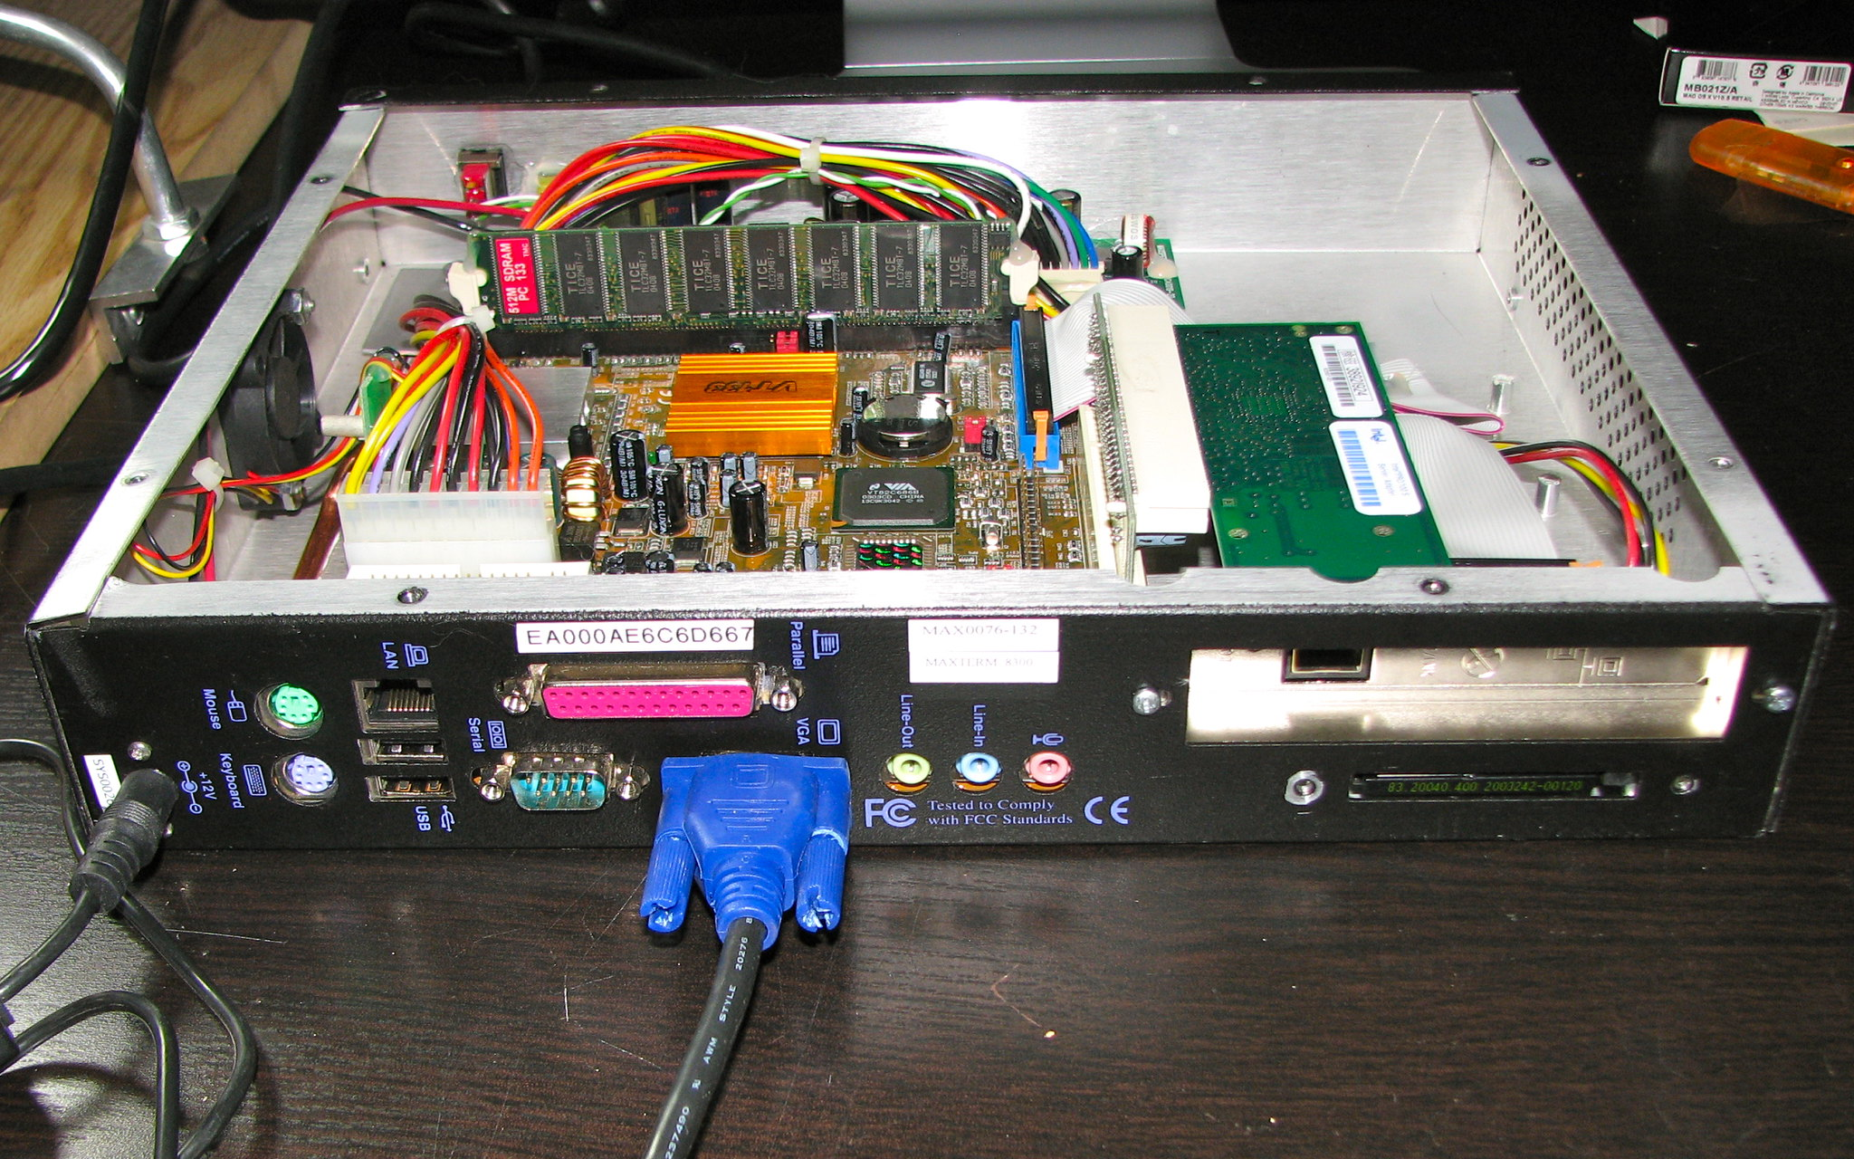
Physical Ports *
* System Back (links in references)
Notes:
Script:
Here we have the physical enclosure for the element that we're considering.
We've taken that
[break]
and created a simplified view of it.
Now let's look at the results of the model creation and apply our physical port questions.

Slide 17
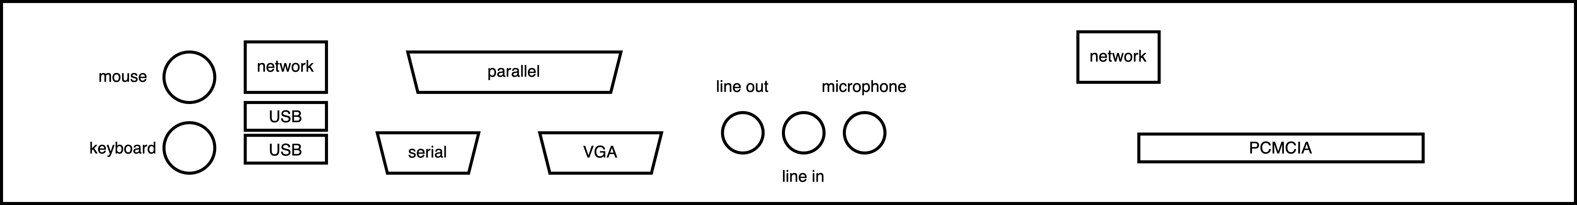
Physical Ports
Notes:
Script:
Here we have the physical enclosure for the element that we're considering.
We've taken that
[break]
and created a simplified view of it.
Now let's look at the results of the model creation and apply our physical port questions.

Slide 18
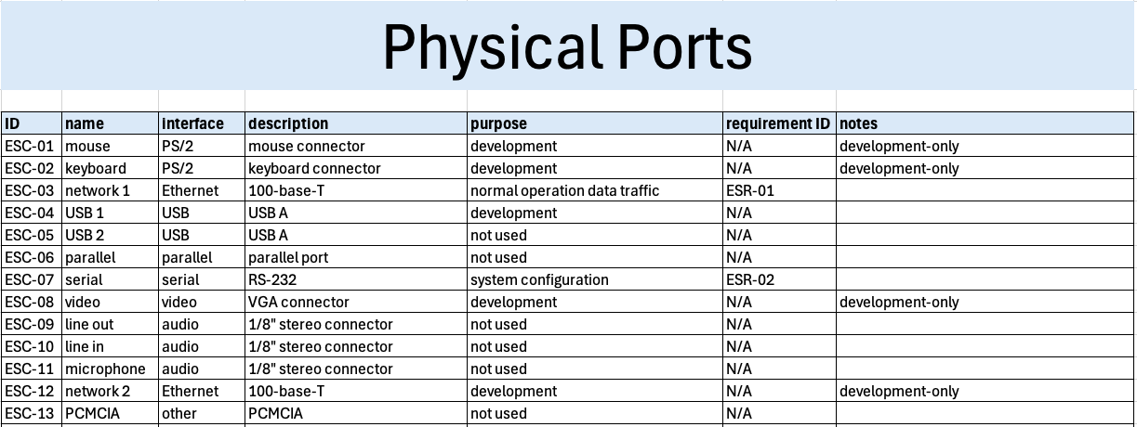
Physical Ports List
Notes:
Script:
Here we have the physical port list from the attack surface analysis model creation activity.
If we start out with our first question, is the port used?
We can see that ESC-5, 6, 9,10, 11, and 13 are not used.
So, those are obviously things that we would like to have removed from the element.
[pause]
Our next question, is the port required for core functionality of the element?
Well, we don't have anything that would indicate that anything is not used for the core functionality, because as we can see, ESC-3, our normal operation data traffic, is the only core functionality we have.
[pause]
Is the port only used for development?
We've got examples of that with ESC-1 and 2, which are our mouse and keyboard.
[pause]
We have ESC-4, which is for development, but it's not noted that it's for development only.
So, there's ambiguity there as to whether we're using it for development and diagnostics, or just for development.
That's something that that should be clarified.
[pause]
We have ESC 8, our VGA connector, which is probably a display to go along with the keyboard and mouse when we're doing development.
[pause]
And we have ESC-12, which is our second Ethernet interface.
When we're looking at things which are development-only, or for development and diagnostics, then we should come back to them when we're doing the attack surface analysis review.
[pause]
Our next question, is this port used for diagnostics?
Again, we have the question as to whether ESC-4 fits into this category.
Because it's a USB port, it could be.
[pause]
Next, is this port required for deployment?
As we can see, we have ESC-7, a serial interface which is used for systems configuration.
[pause]
Finally, is the port removable?
For this, we go back to the photograph of the element and we can see whether any ports of interest might be removable.

Slide 19
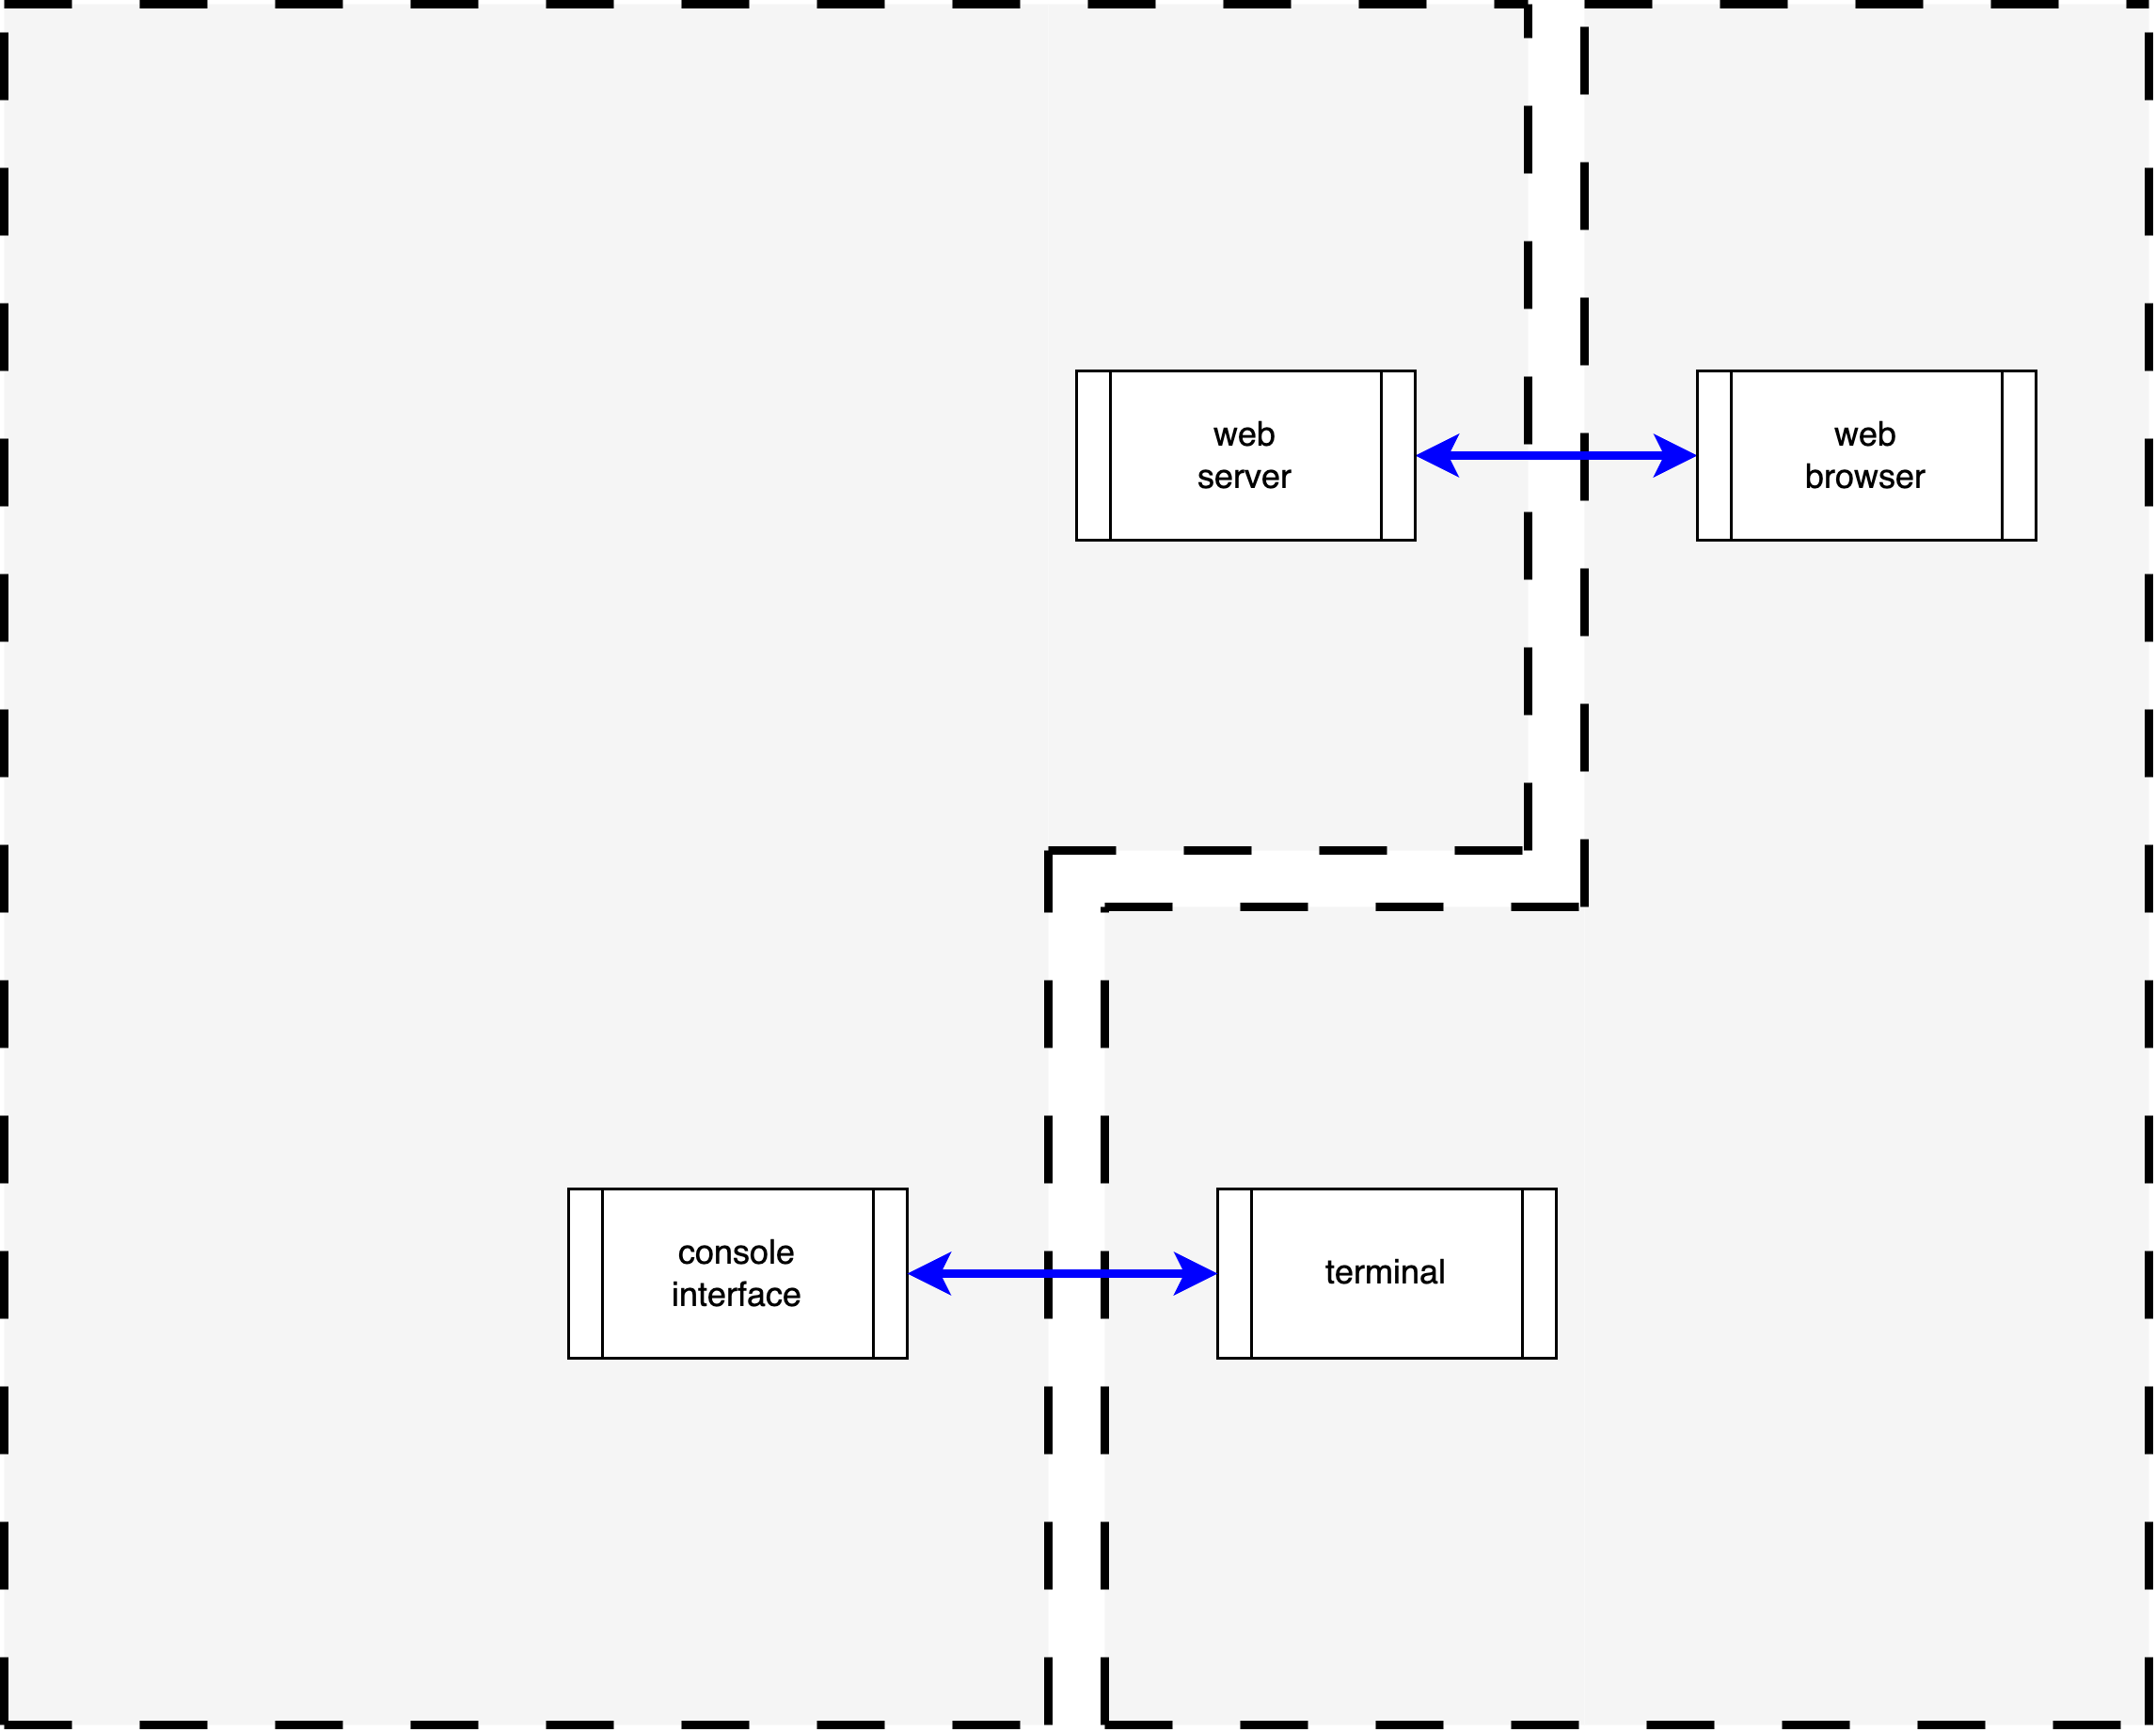
Logical Ports / Protocols
Notes:
Script:
Next, we'll look at our logical ports and protocols.
[pause]
As we see here, this is our block diagram stripped down to just show our two interfaces.
One is an Ethernet interface, and the other a serial interface.
So, let's look at those.

Slide 20
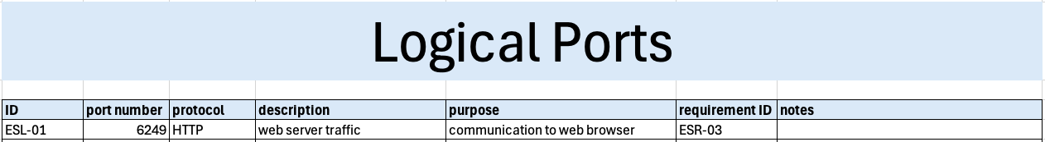
Logical Ports / Protocols List
Notes:
Script:
When we look at our logical ports and protocols list, we can immediately see that the serial port isn’t listed here.
We can look at this in one of two ways.
The first is that it's been forgotten, and that you're going to have to add in an ESL-2.
The other is that this is an RS-232 serial interface which has already been defined as being used for configuration.
The fact that it is a required interface, and we know that it's an RS-232 interface, implies that there's no logical port associated with it.
And so, there's no necessity to include it, but you're free to include one if you want to take the view that all of the things need to be listed.
Setting that aside, let's look at what we have here.
[pause]
Our first question, is the port used?
Yes, this is defined as the communication to and from the web server.
[pause]
Next question, is the port number appropriate?
We look at our protocol and see that it’s HTTP.
We look at the port number and we see that it’s 6249.
We know immediately that this port number is not appropriate for this protocol.
The port the HTTP traffic should be on port 80.
Now this is different from the question of is the protocol correct and we'll get to that.
So, we have an issue with the port number.
[pause]
Next, is the port required for the core functionality?
Yes, it is.
It's our communication to the web server.
[pause]
Is it required during development?
Since it's a core functionality requirement, this isn’t relevant.
[pause]
It's not just for diagnostics.
[pause]
It's not used for deployment.
We don't actually deal with provisioning in this element.
[pause]
Is the port owned by a single process?
We don't know.
That would be something defined in the requirement, in this case, ESR-3.
[pause]
Is the port only open for the duration of the required operation?
Again, we don't know and we can explore that during the attack surface analysis review.
[pause]
Finally, does the protocol running on the port require non-trivial authentication?
And here we get into the question of whether this the appropriate protocol to be using.
If we were to use HTTPS, then we would have the ability to say, yes, we're not using trivial authentication here, but since we’re using HTTP, there’s no authentication.
This is an example of why you look at logical port and protocol in combination.

Slide 21
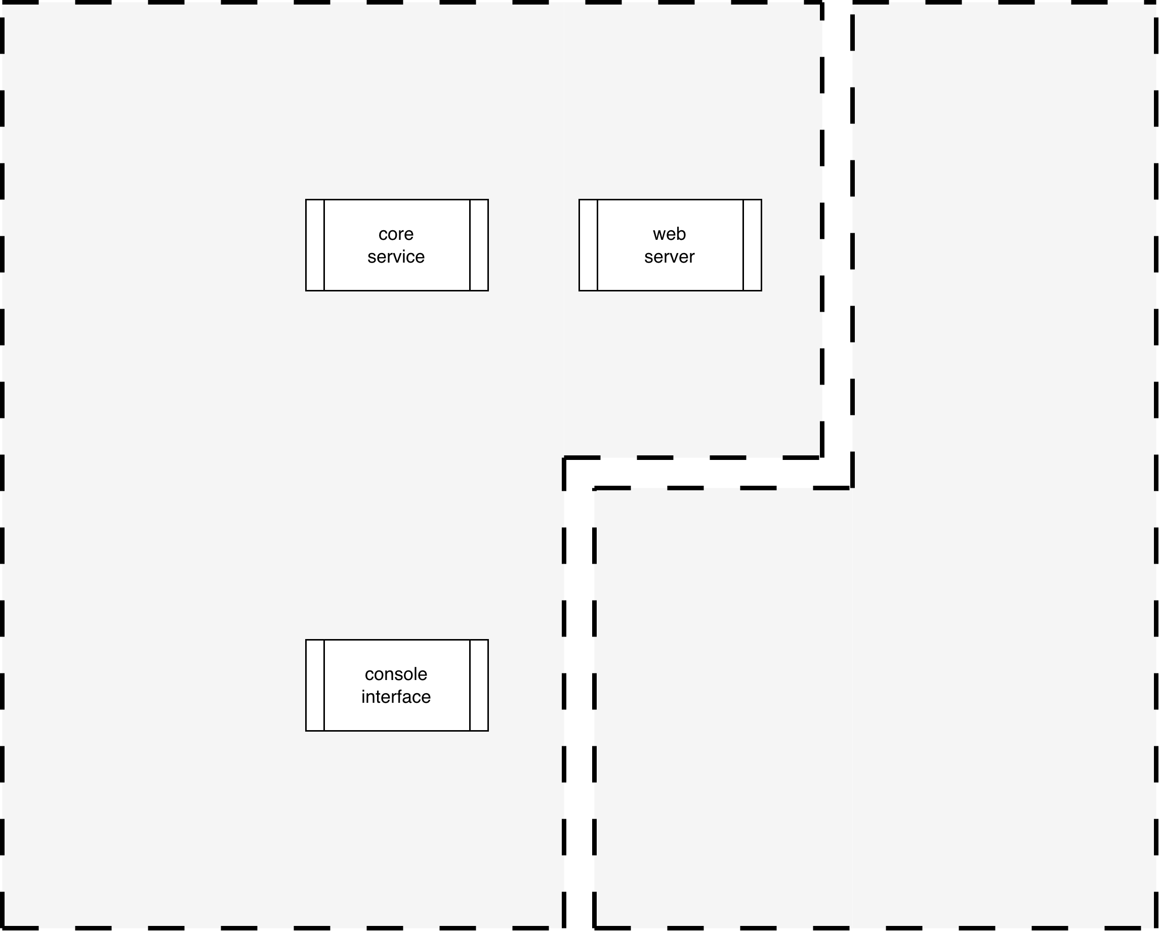
Processes
Notes:
Script:
Here’s our block diagram showing just the element’s processes.
We have the
[pause]
core service,
[pause]
web server, and
[pause]
console interface.
Let's look at that these and answer some questions.

Slide 22
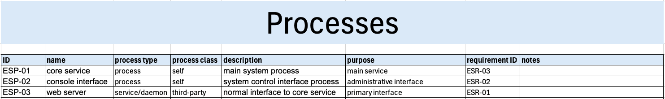
Processes List
Notes:
Script:
Here we Unlike the list of logical ports and protocols, here the processes are completely enumerated.
[pause]
Our first question, is the process used?
In this case, yes, all of these processes are required.
[pause]
As to whether the processes are core to the operation of the element, that becomes a discussion point when you're talking about the
[pause]
console interface, but for
[pause]
ESP-1 and 3, the core service and the web server, those are integral to the operation of the element.
[pause]
Are any of the processes used only during development?
The answer for that is no.
These are all production processes.
[pause]
None of these processes are only required for diagnostics.
[pause]
As to whether a process has a unique owner, this is an interesting question that we can't identify at this point based on the information we have in the design phase.
It's going to be available to us when we're doing the attack surface analysis review in the verification phase.
[pause]
Is the process required to be privileged?
Again, this may not be well-defined at this point in time.
[pause]
Is the process used for deployment?
Within the context of what we know about this particular element, we can't say.
[pause]
And finally, is the process a manager of a system-critical resource.
Both the console interface and the core service are managing resources which are critical to the system.
In later activities we will use this information.

Slide 23
Issues
Notes:
Script:
Now let's consider what we do with the issues that we've identified.

Slide 24
Categorization
Required
Core
Supporting
Deployment (provisioning / update / decommissioning)
Development
Diagnostic (debug-only)
Unjustified (out-of-specification)
Unused
need to be raised as issues
Notes:
Script:
For all of the potential concerns that we have within the context of this example, not everything rises to the level of being an issue.
To understand that better, let's look at a categorization that takes all of the ports, protocols and processes, and puts them into buckets.
From that, we'll be able to see which of the things that we have concerns with really need to be addressed as issues.
[pause]
First, we have things which are required.
These fall into one of two sub-categories.
[pause]
They can either be core, the system will not function without it.
[pause]
Or, by extension, there are those things which are supporting.
The required category gets a pass regardless of the sub-category.
These are things that we have to have, and that should be there.
We're taking note of what's core and what's supporting, because if we have to put the system into a degraded state, we need to know what those entities are.
[pause]
Next, we have those things which are required for deployment, and by this we mean provisioning, update, and decommissioning.
These are obviously required, but temporally contextual.
They do not need to be active all the time, nor should they be from the perspective of pressure on the system.
[pause]
Next we have those things which are for development.
Taking into consideration the fact that we are doing an attack surface analysis in the design phase, we can't speak to the eventual disposition of these concerns.
We know that they're being used now, but by the time we get to the verification phase they should be no longer in use.
So again, this is informational for us at this juncture.
We'll get to the verification phase and do the attack surface analysis review, then ask whether these have been turned off?
[pause]
Finally get to the area where we have concerns that will need to be addressed.
[pause]
The first is that of diagnostics.
These should not be active continuously.
We should not have exposure for diagnostic ports on the physical surface of the element.
This gets us to the question of do we have things that are physical interfaces which can be removed.
And do we have adequate controls in order to prevent the diagnostics, which tend to have more intrusive access into things than we would like, from being misused.
[pause]
The next are those things which are simply unjustified.
They're either out-of-specification.
For instance, the issue identified with the logical ports and protocols.
Or there is no underlying requirement to justify its presence.
For instance, you've got a web server on a sensor, but there's no reason for a web server to be present.
It's not required for the functionality.
[pause]
And finally, we have those things which are unused.
[pause]
These last three are the categories we need to raise as issues.
The rest are informational but may be of use in later cybersecurity activities.

Slide 25
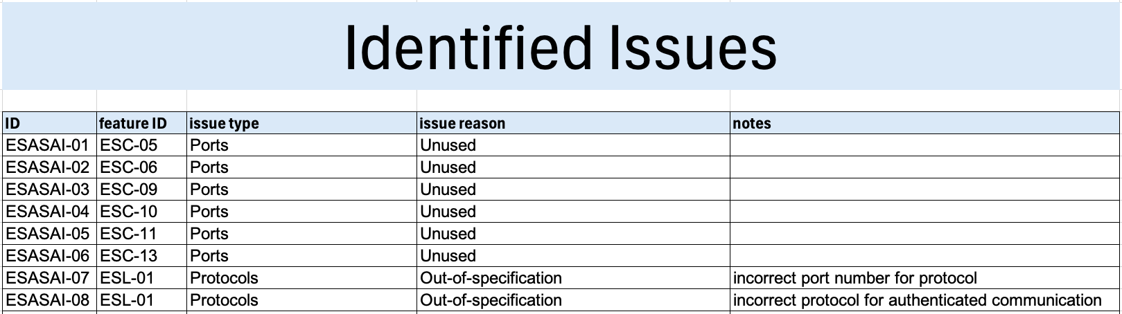
Identified Issues
Notes:
Script:
With all of this in mind, we can compile our list of identified issues that we're going to need to dispatch.
The AVCDL document Attack Surface Analysis - Analysis Procedure details the various issue types and issue reasons, which as noted in categorization section are things like debug-only, out-of-specification, and unused.
The issue types listed in the analysis procedure document go beyond the scope of what we've discussed here because the approach that's being used is determined by the fact that we are in the design phase, so there are going to be issue types which we don't have visibility into.
When we get to the attack surface analysis review, we will have a complete system and element and at that point we’ll be able to address these things.
But at this point, some of the issue types won't be applicable.
We’ve covered ports, protocols, features, and diagnostics, but data connection lifetimes and data structures are not going to be able to be addressed.
They're included for completeness.
[pause]
Once we have our identified issues, they can be fed into the triage activity.

Slide 26
Recap
Notes:
Script:
With that we've covered the analysis activity we use for the attack surface analysis process.
Now let's look at our takeaways.

Slide 27
Summary
Review the model
Focus on information provided
Development / deployment aspects need production plans
Keep it up-to-date
No special tooling required
Notes:
Script:
First, review the model.
Whenever you're doing any type of analysis, look over the model to see if it's coherent.
As you're proceeding with the analysis, if there's information that's missing, then go back to the model documentation and query the development SME involved in the creation of the model.
[pause]
Next, focus on the information provided.
This goes along with the first item.
Don't make assumptions about the element.
Always work from the information that you actually have.
[pause]
Although they won't generate issues that need to be addressed right now.
The development and deployment aspects are going to require production plans, and development should be reminded of this.
They should know that this is the case, but it never hurts to remind development that something is going to needed to be in place to address these issues.
And obviously, when we do the attack surface analysis review, we’ll come back and look at these more stringently.
[pause]
Next keep the analysis up-to-date.
If the element changes, then the attack surface analysis is also subject to change.
[pause]
And finally, keep in mind that you don't require any special tooling to do this type of analysis.
The set of questions and methodology, both lend themselves to a purely pen-and-paper exercise.

Slide 28
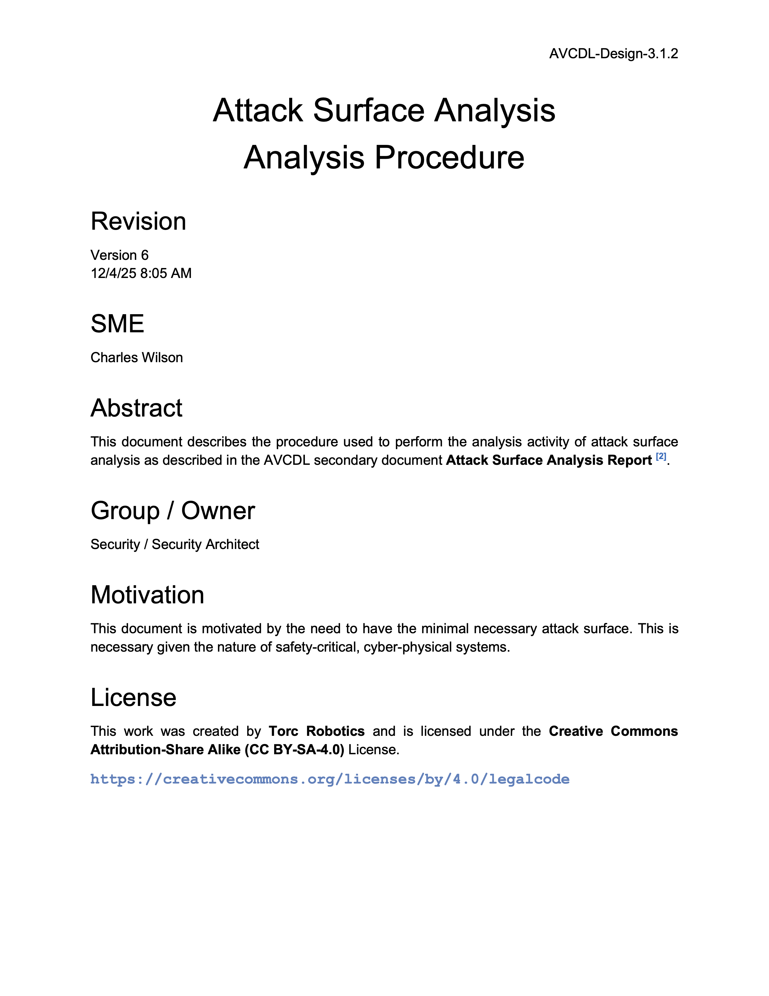
Further Reading
Notes:
Script:
For additional information and to get a more in-depth set of references, the Attack Surface Analysis Analysis Procedure tertiary document is available in the AVCDL GitHub repository.

Slide 29
Example Materials
<AVCDL>/source/reference_documents/working_material/example system/
Notes:
Script:
The materials that were used to cover this example are in this location shown here.

Slide 30
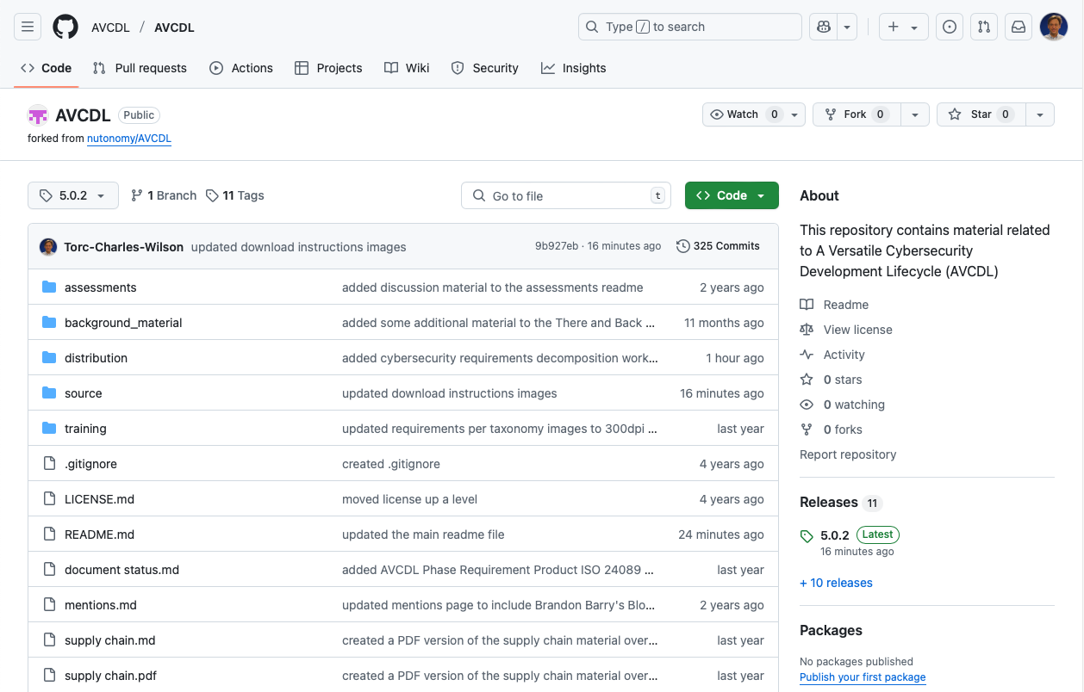
AVCDL on GitHub
https://github.com/AVCDL/AVCDL
Notes:
Script:
All AVCDL materials, both in source and distribution forms, are available on our GitHub site, as shown here.
Because of the size of the repository, it's recommended that you either clone the repository or download a ZIP archive of it, if you're not familiar with using git.
Instructions for downloading a ZIP archive are linked to on the repository’s front page.

Slide 31
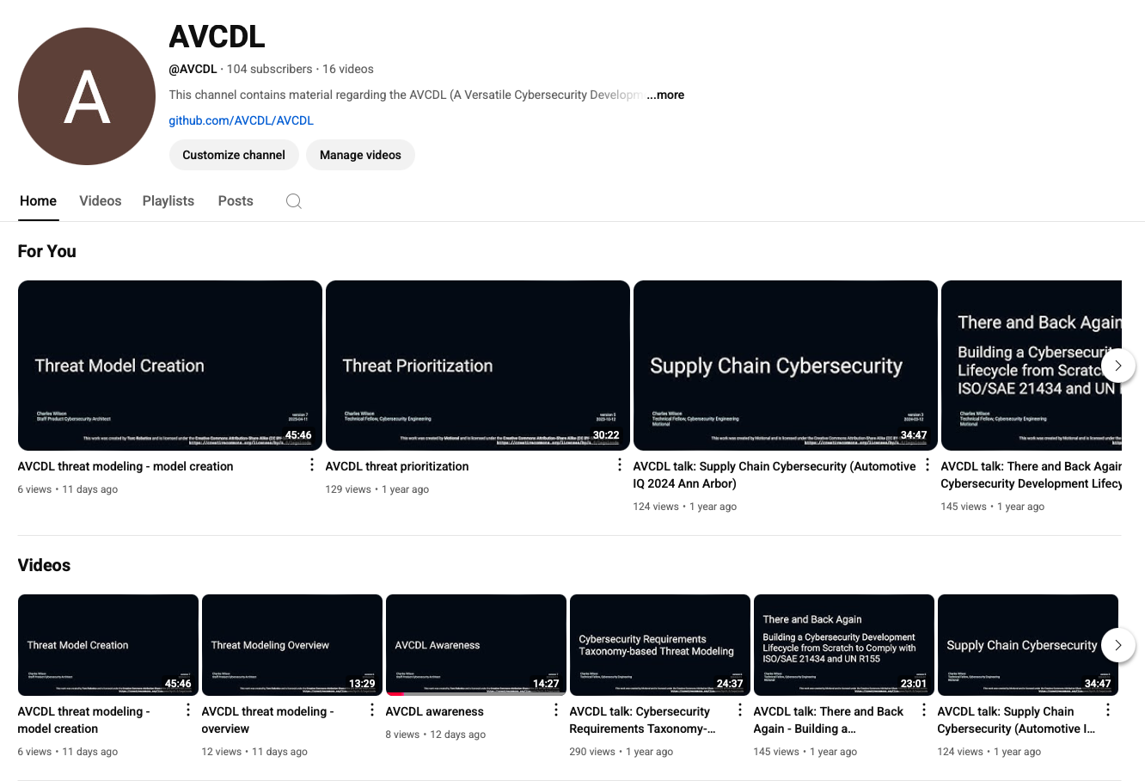
AVCDL on YouTube
https://youtube.com/@AVCDL
Notes:
Script:
A set of training videos have been created to cover various aspects of the AVCDL that follow the training path found in the AVCDL primary document.
It's important to note that all AVCDL materials except for the introductory blog posts are intended for product cybersecurity engineering practitioners.

Slide 32
Next Steps
Notes:
Script:
With this training complete,
once you've completed the other trainings related to attack surface analysis, you can proceed to one of the other trainings at this level.
These include:
• threat modeling
• penetration testing
and
• vulnerability identification

Slide 33
References (1 of 2)
AVCDL primary document
Attack Surface Analysis Report (AVCDL secondary document)
Attack Surface Analysis Analysis Procedure (AVCDL tertiary document)
AVCDL attack surface analysis model template (AVCDL template)
AVCDL attack surface analysis issues template (AVCDL template)
Threat Modeling Report (AVCDL secondary document)
Threat Prioritization Plan (AVCDL secondary document)
Notes:
Script:
Here are references to the source material used in the creation of this presentation.
They'll also be included in the video description.
Additionally, this presentation’s source material will be provided on the AVCDL GitHub repository.

Slide 34
References (2 of 2)
Service Name and Transport Protocol Port Number Registry
https://www.iana.org/assignments/service-names-port-numbers/service-names-port-numbers.xhtml
NIST SP 800-63 Digital Identity Guidelines
https://www.nist.gov/identity-access-management/nist-special-publication-800-63-digital-identity-guidelines
RFC 6335: Internet Assigned Numbers Authority (IANA) Procedures for the Management of the Service Name and Transport Protocol Port Number Registry
https://www.rfc-editor.org/rfc/pdfrfc/rfc6335.txt.pdf
Notes:
Script:
Here are references to the source material used in the creation of this presentation.
They'll also be included in the video description.
Additionally, this presentation’s source material will be provided on the AVCDL GitHub repository.

